Slide 1

Smart Airport
by ZEN
Jiajun Deng & Zhouxiang Wu

Slide 2
Why is this idea?
Complaining Passengers
Inefficient management
Coarse, based on holiday seasons
Notes:
The idea came from the desire to deal with complaining passengers and improve inefficient management in International airport.

Slide 3
What is the Smart Airport?
To predict the time consumption.
Custom Entry
Baggage Claim
Security Check
Resources can be managed by staffs.
Passengers number
Time Prediction
Allocate staffs precisely
Notes:
What we wanted to do, was firstly to predict the time consumption of services related to passengers, like, custom entry, baggage claim and security check.
Then help implement the resources management, for example, allocate staffs precisely based on the number of passengers and predicted service time.

Slide 4
Prediction Model
Passengers' number prediction based on Big Data
Experience data
Data from Airline Companies
Assume we have the number of passengers.
Waiting time prediction
Waiting Algorithm: Malkov Queuing Theory
Notes:
In the limited time, we implemented the service time prediction model,
based on Malkov Queuing Theory.
(In this model, when we know the arriving rate of passengers, the sevice rate of officers and the number of officers, the waiting time can be predicted.)

Slide 5
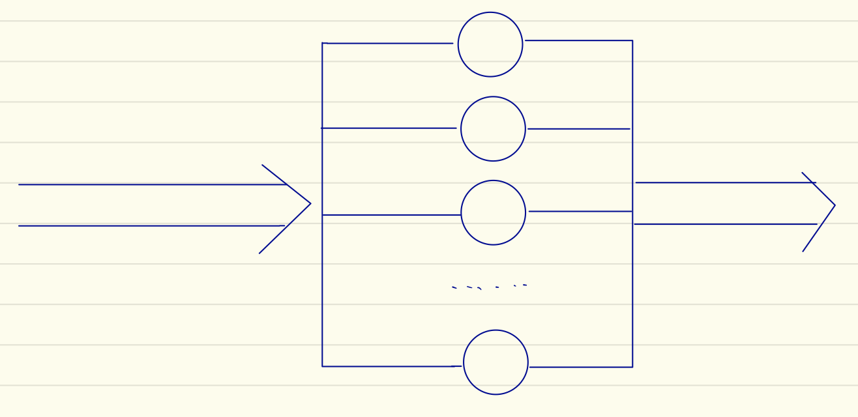
Malkov Queuing Theroy
Arriving Rate l
Waiting Time
Officers Number / Working Rate

Slide 6
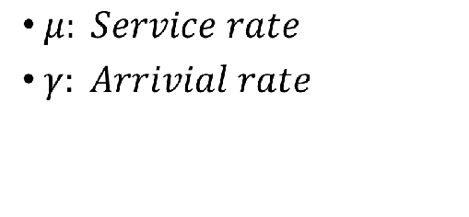
Malkov Queuing Theroy
Arriving Rate l
n: Number of Officers

Slide 7
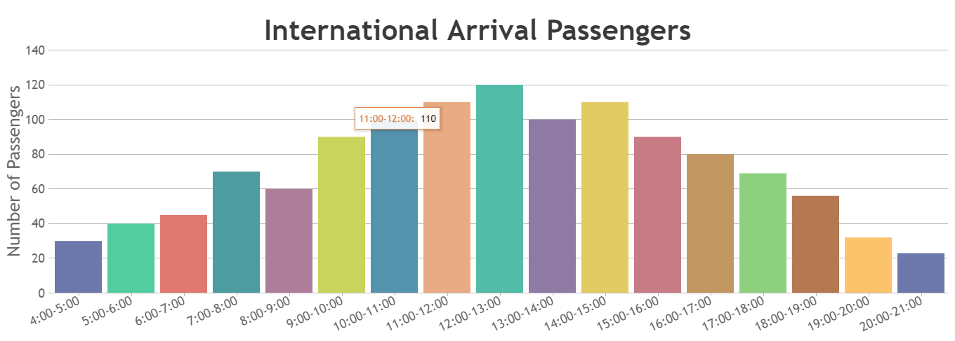
Precision
Passengers Number/Service Waiting Time
Everyday and every hour
Arriving Rate l

Slide 8
Management
Peak time work arrangement
Predicted time is an important basis for a manager to make a decision.
In this project, the manager can adjust the number of working officers.
Notes:
For the management, we implemented peak time work arrangement, in which the manager can adjust the number of working officers to decrease the waiting time. Interactively shown on the web page.

Slide 9
Future work
Implement the Passengers’ number Prediction Model
Include the schedule of all employers
Implement the web project in spring framework

